Slide 1

Development of web application components
for semantic annotation of datasets
Master's thesis
Author: Bc. Peter Plevko
Supervisor: Ing. Miroslav Rác
23.01.2024

Slide 2
Introduction
Semantics: Study of word and sentence meaning.
Semantic Annotation: Adding meaning to data by tagging it with relevant information.
Importance in Business Intelligence: Semantic annotation turns daily data into meaningful information.

Slide 3
Goals
Implementation of a web environment that simplifies the process of creating a semantic annotation
Managing and displaying annotations
Adding datasets, their subsequent annotation and export
Ensuring efficient data processing and supporting the evaluation of AI models.
Deploying the application to the cloud

Slide 4
Technologies
Frontend: Vue.js
CSS framework: Tailwind
UI component library: PrimeVue
Backend: NestJS
Database: Neo4j, PostgreSQL
Cloud Provider: Google Cloud Platform (GCP), firebase

Slide 5
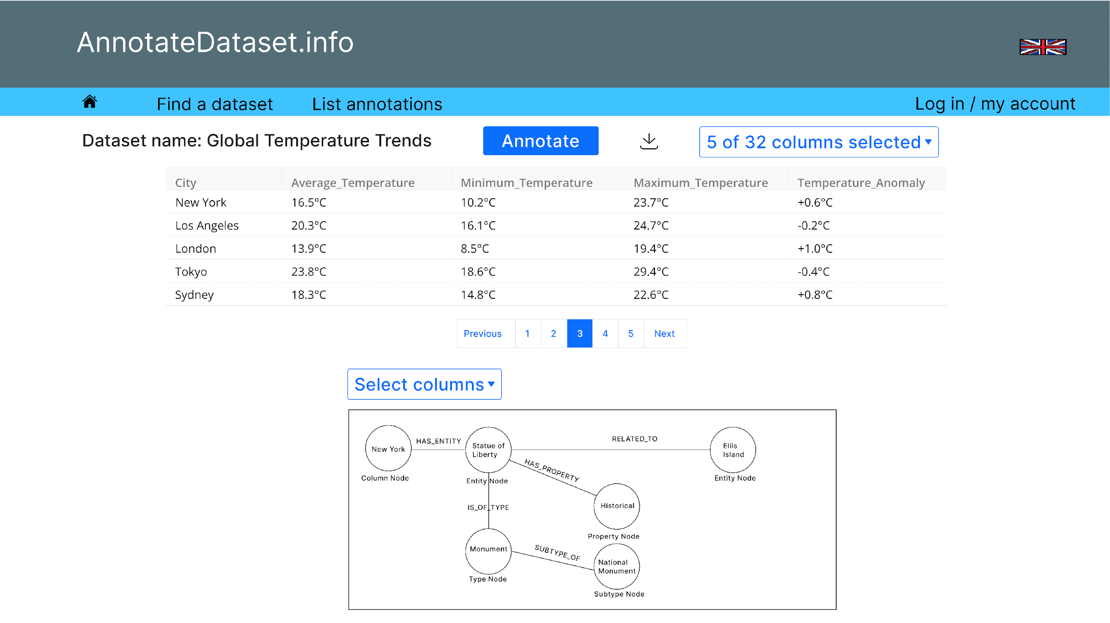
Wireframes

Slide 6
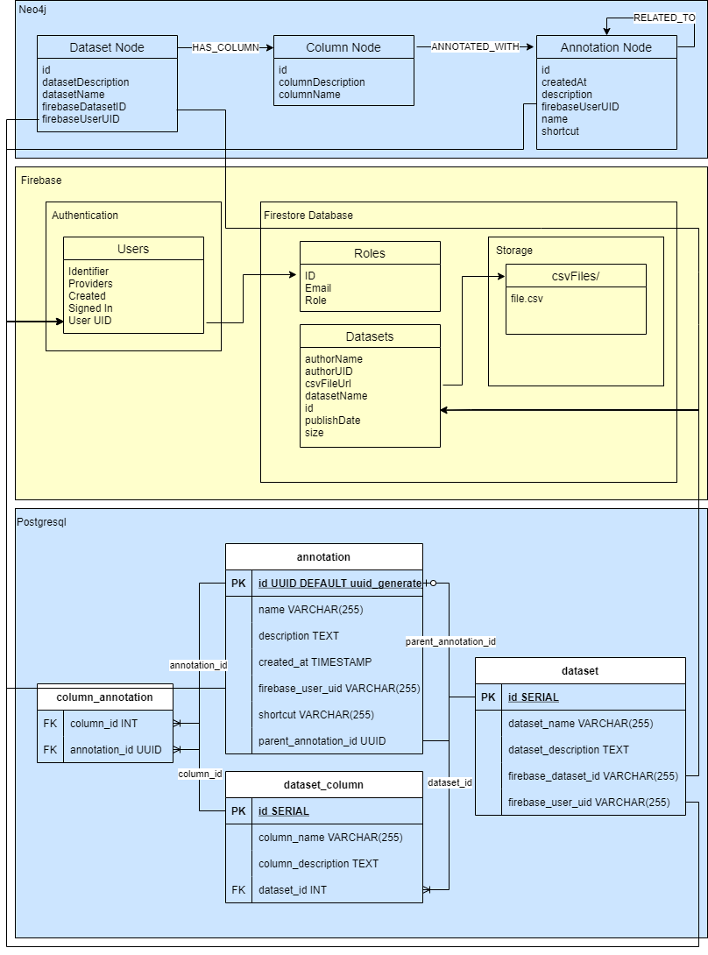
Database model

Slide 7
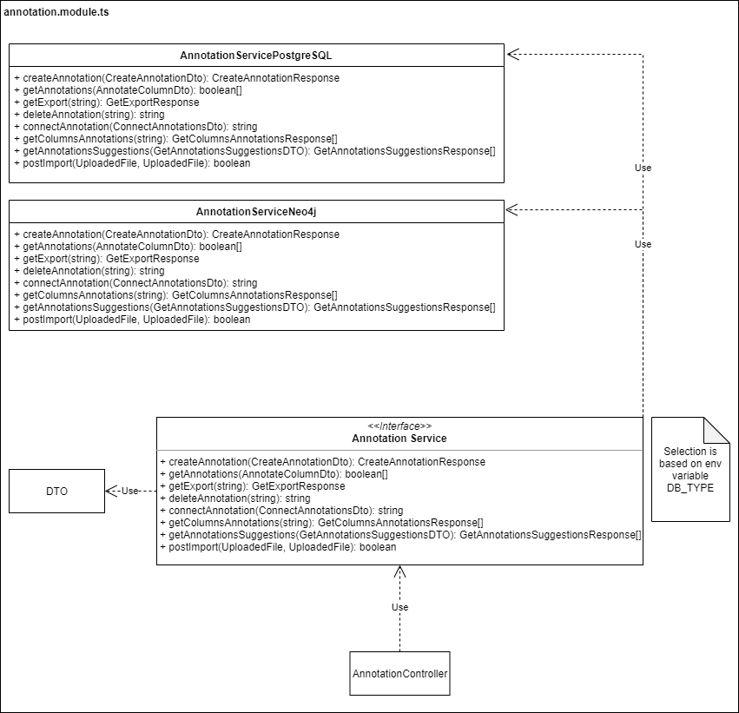
Using a different database with the repository pattern

Slide 8


Visualization tools
neovis.js
vis-network

Slide 9
Seeders
customer_conversion_training_dataset
conversion_data
mkt_synthetic
KAG_conversion_data
Ecommerce Customers

Slide 10
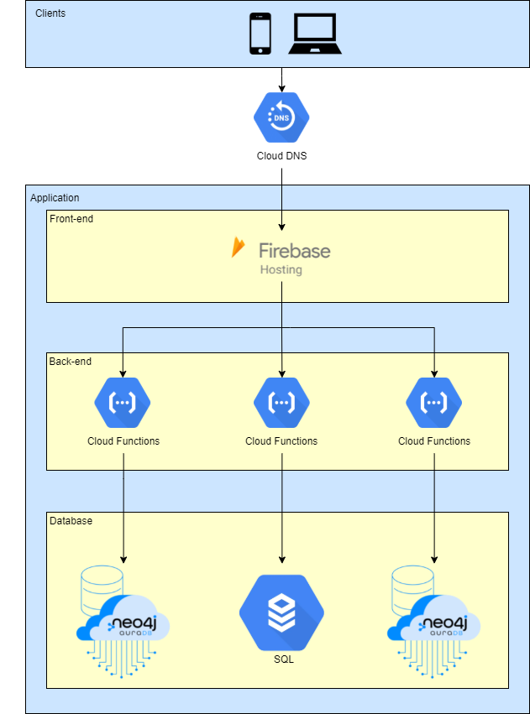
Google Cloud infrastructure diagram

Slide 11
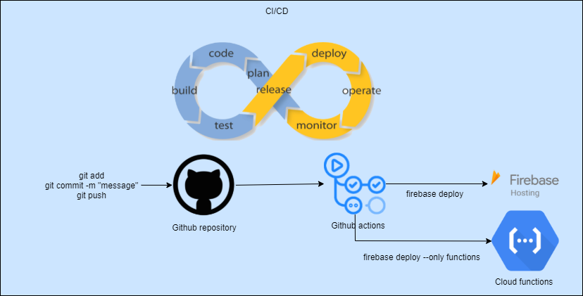
CI/CD

Slide 12
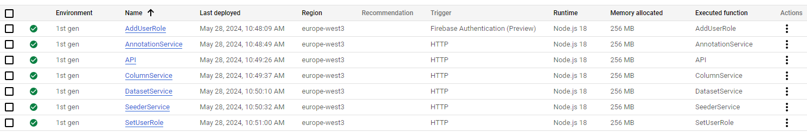
Cloud functions

Slide 13
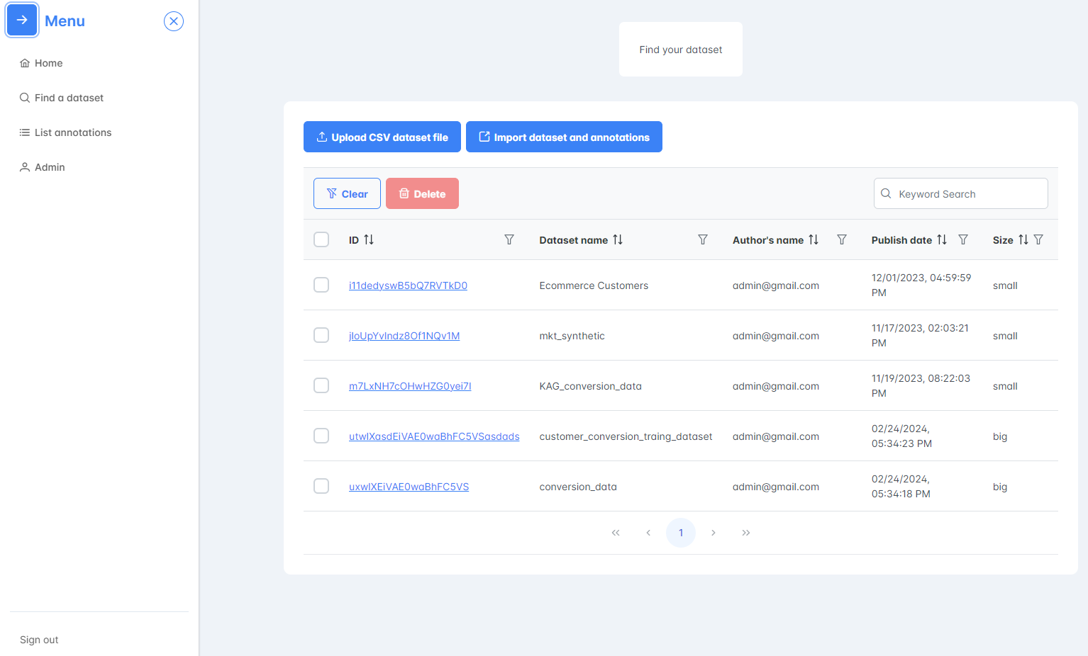
Find a dataset page

Slide 14
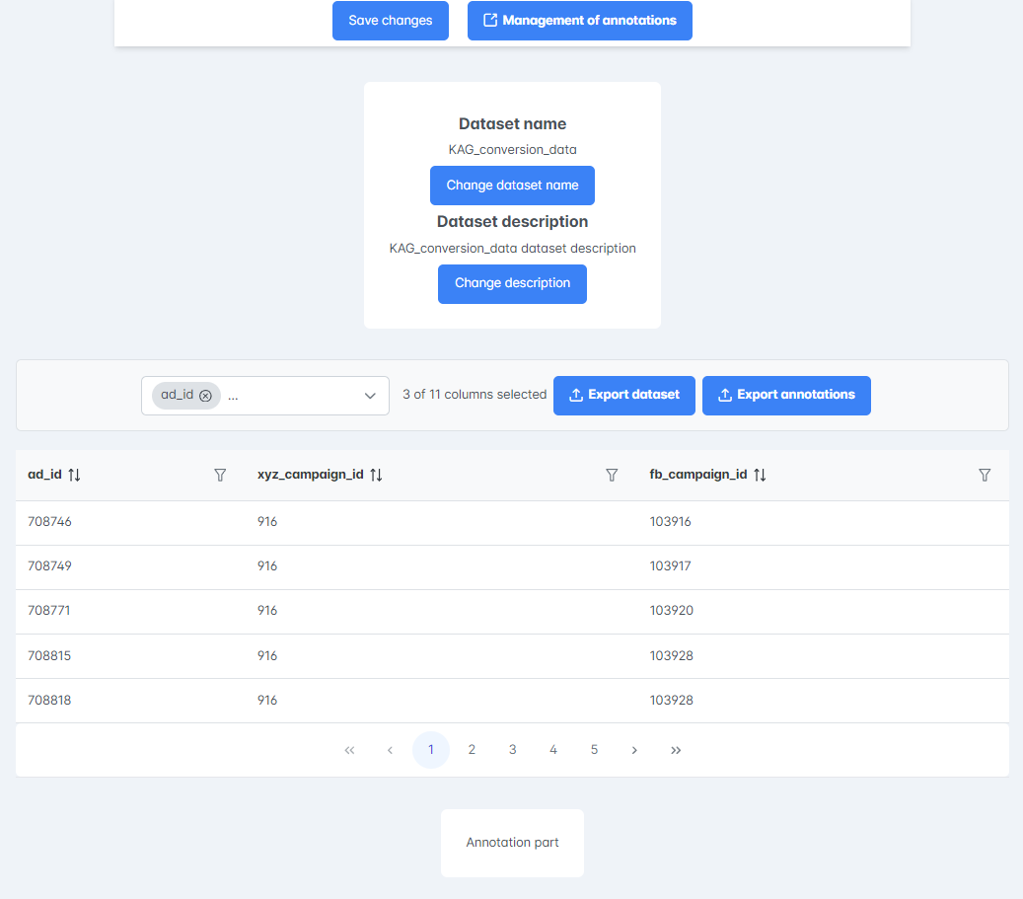
Selected dataset page 1

Slide 15
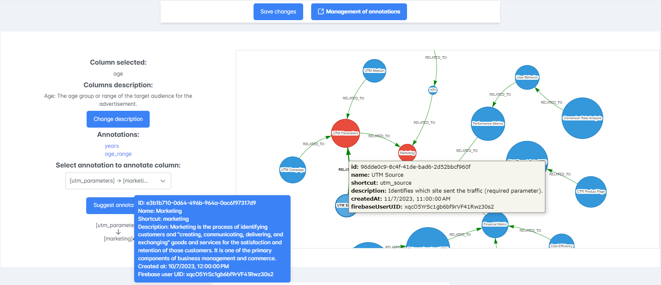
Selected dataset page 2
‹#›/24

Slide 16
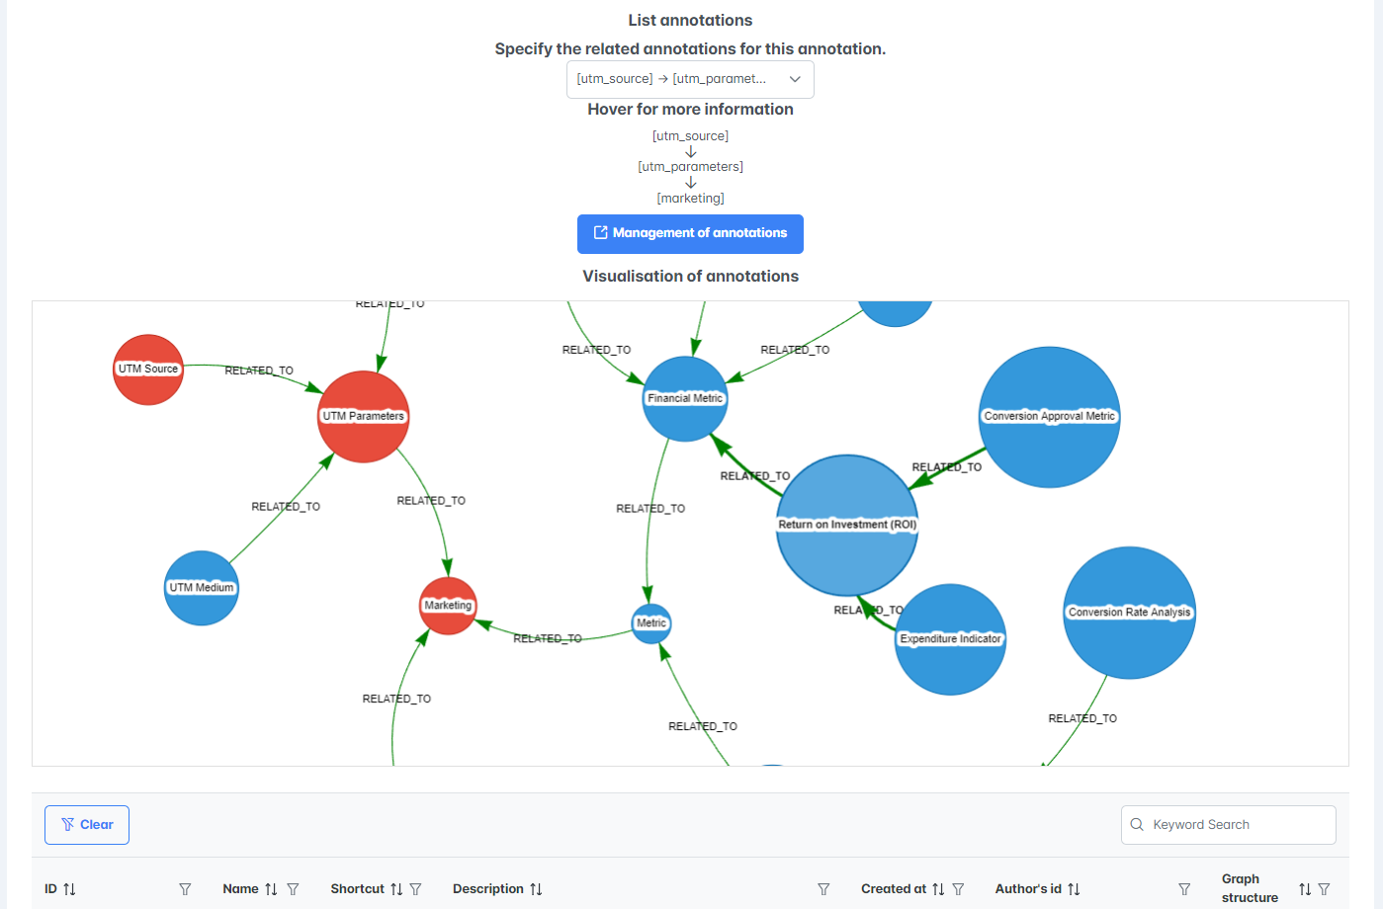
List annotations page

Slide 17
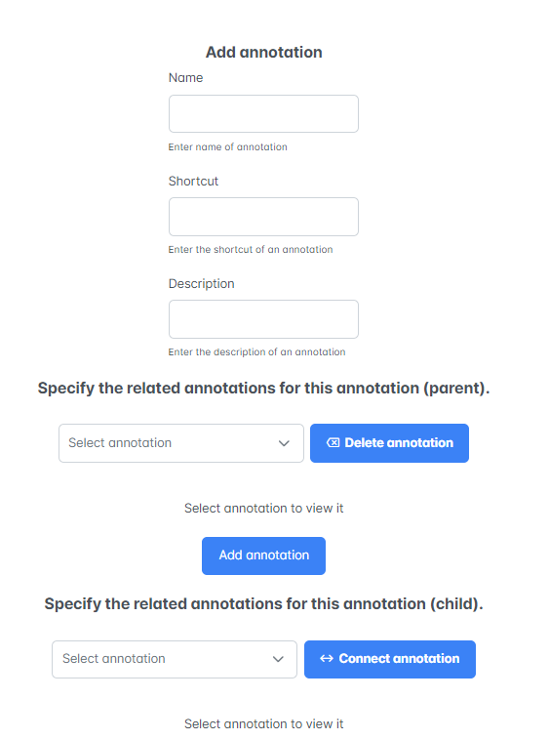
Management of annotations page

Slide 18
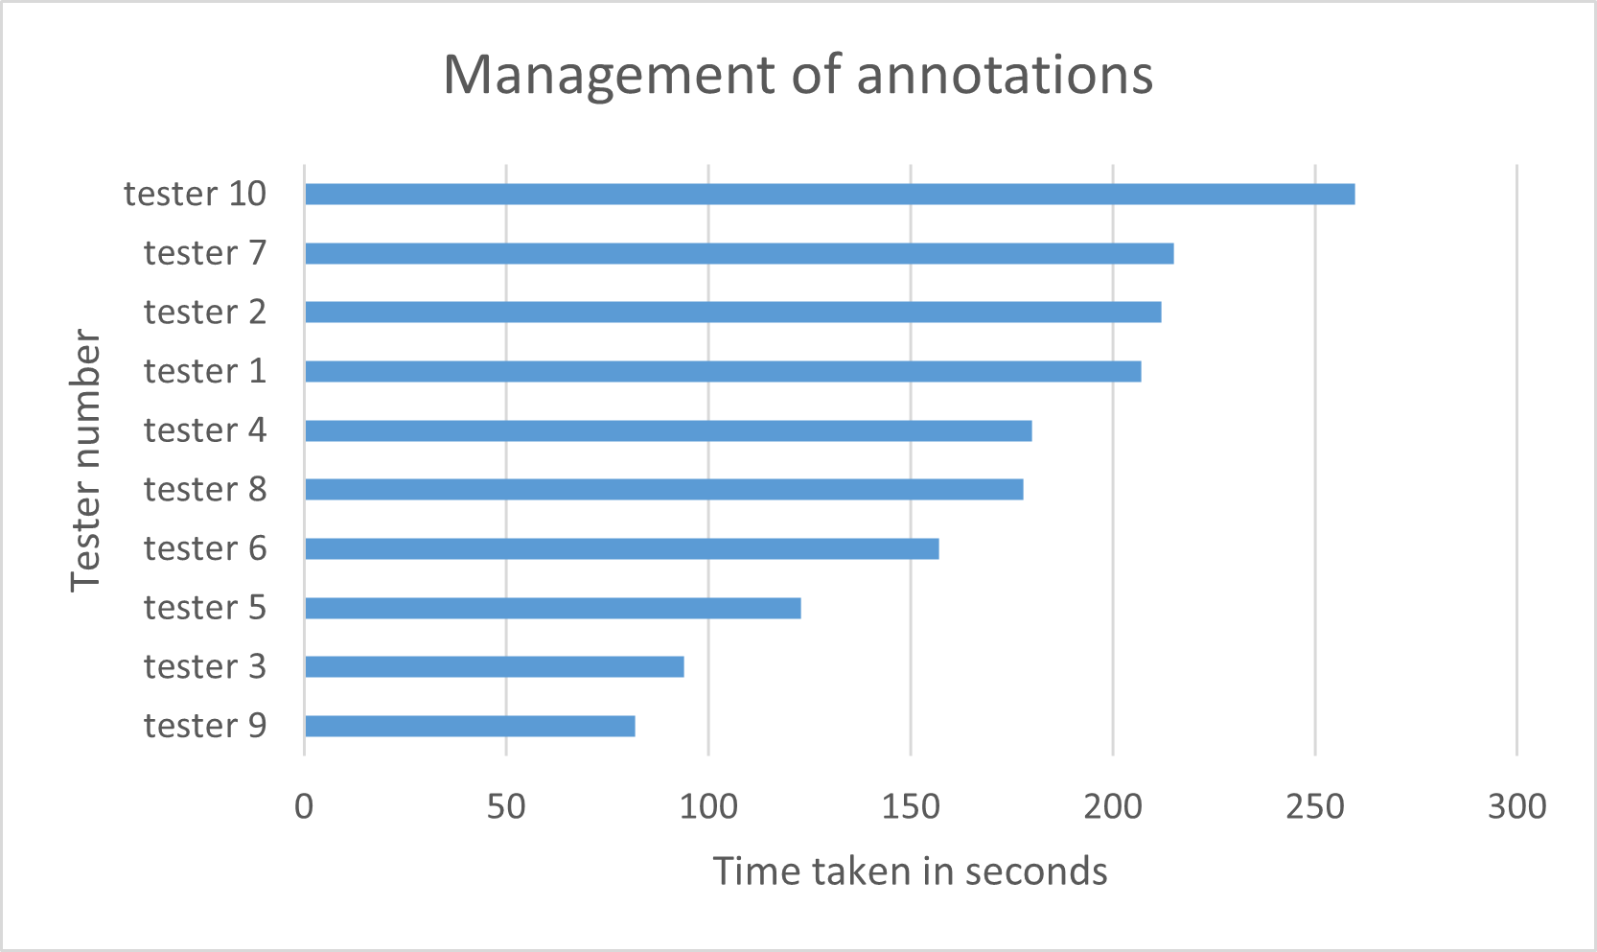
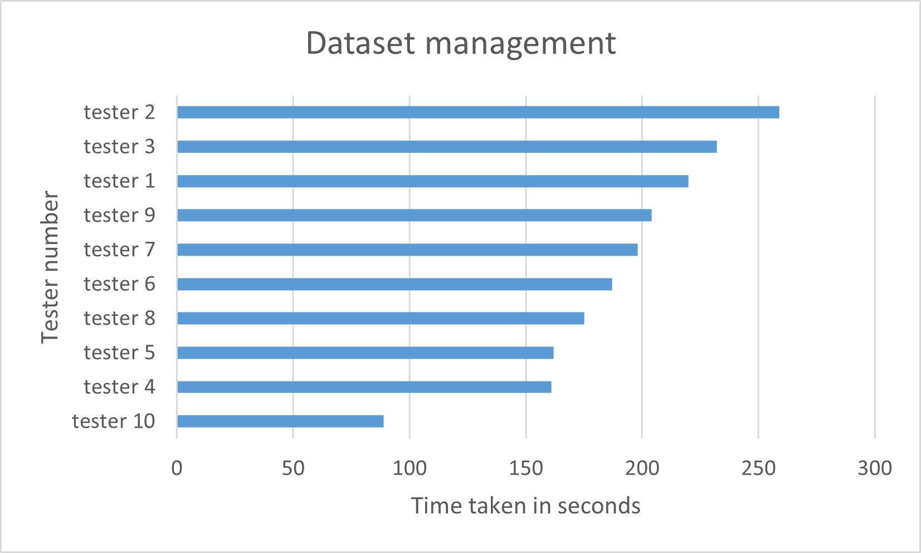
User testing
Average: 169 seconds
Median: 179 seconds
Standard deviation: 49 seconds
Average: 188 seconds
Median: 192 seconds
Standard deviation: 40 seconds

Slide 19
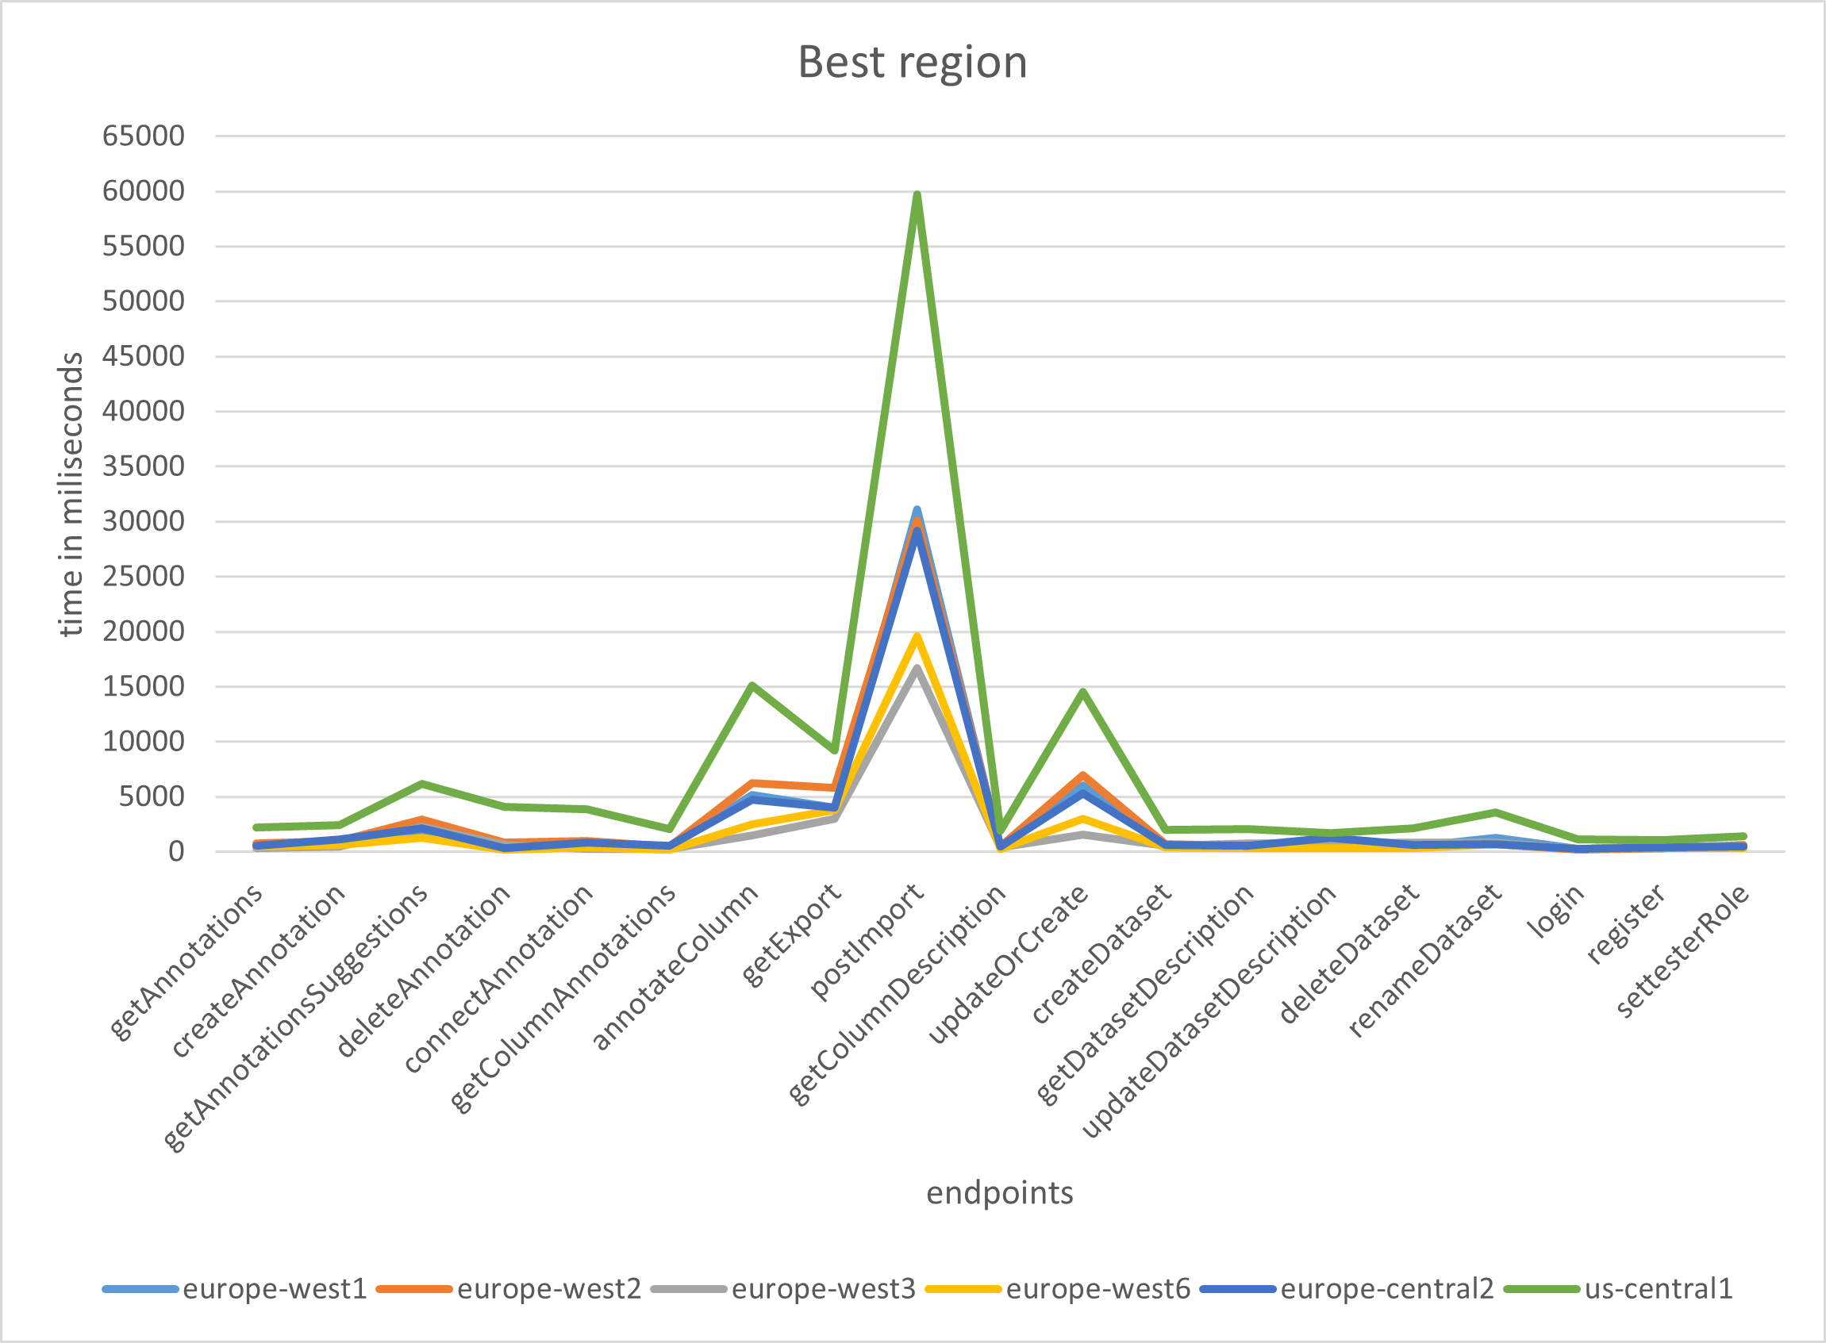
Analyzing Optimal Regions

Slide 20
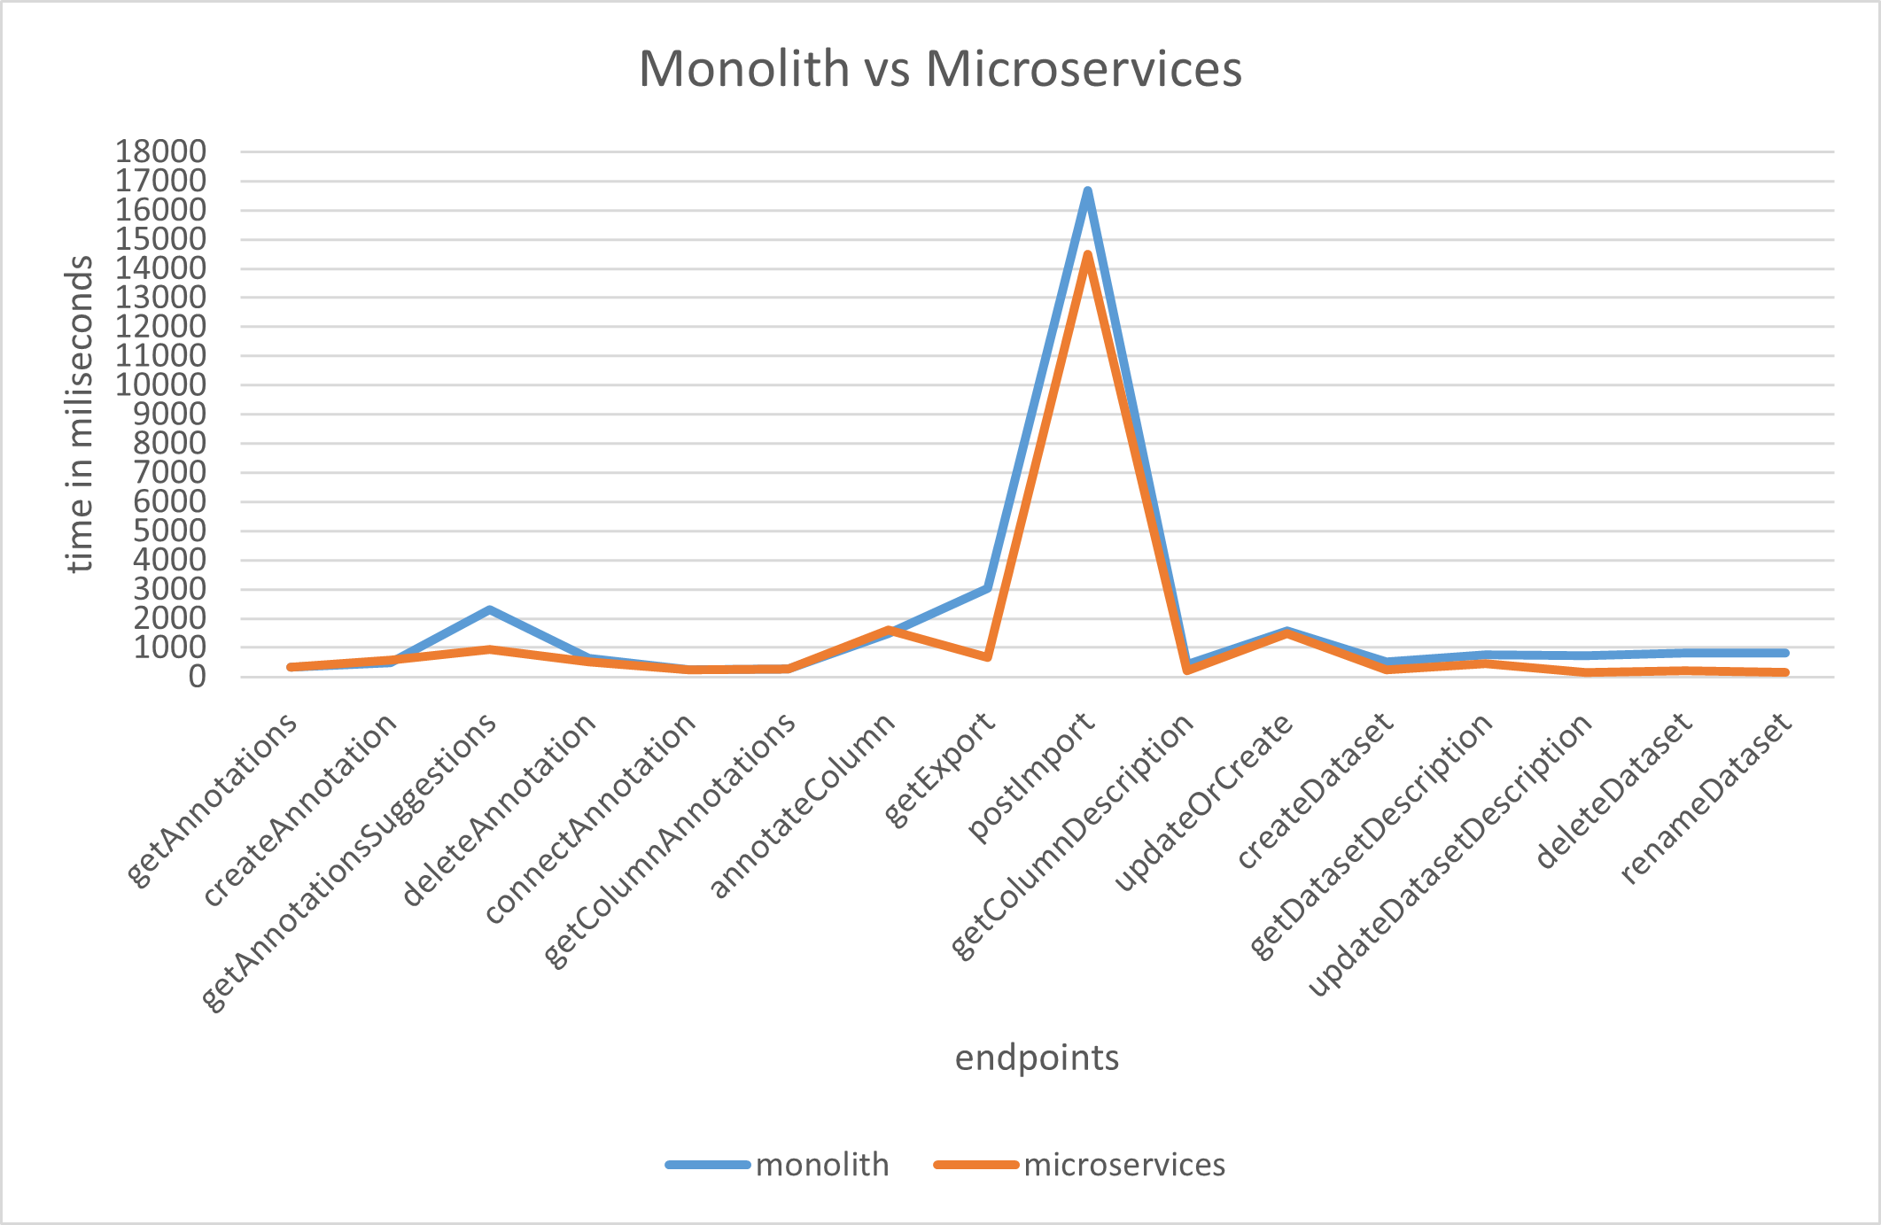
Comparing Monolith vs Microservices

Slide 21
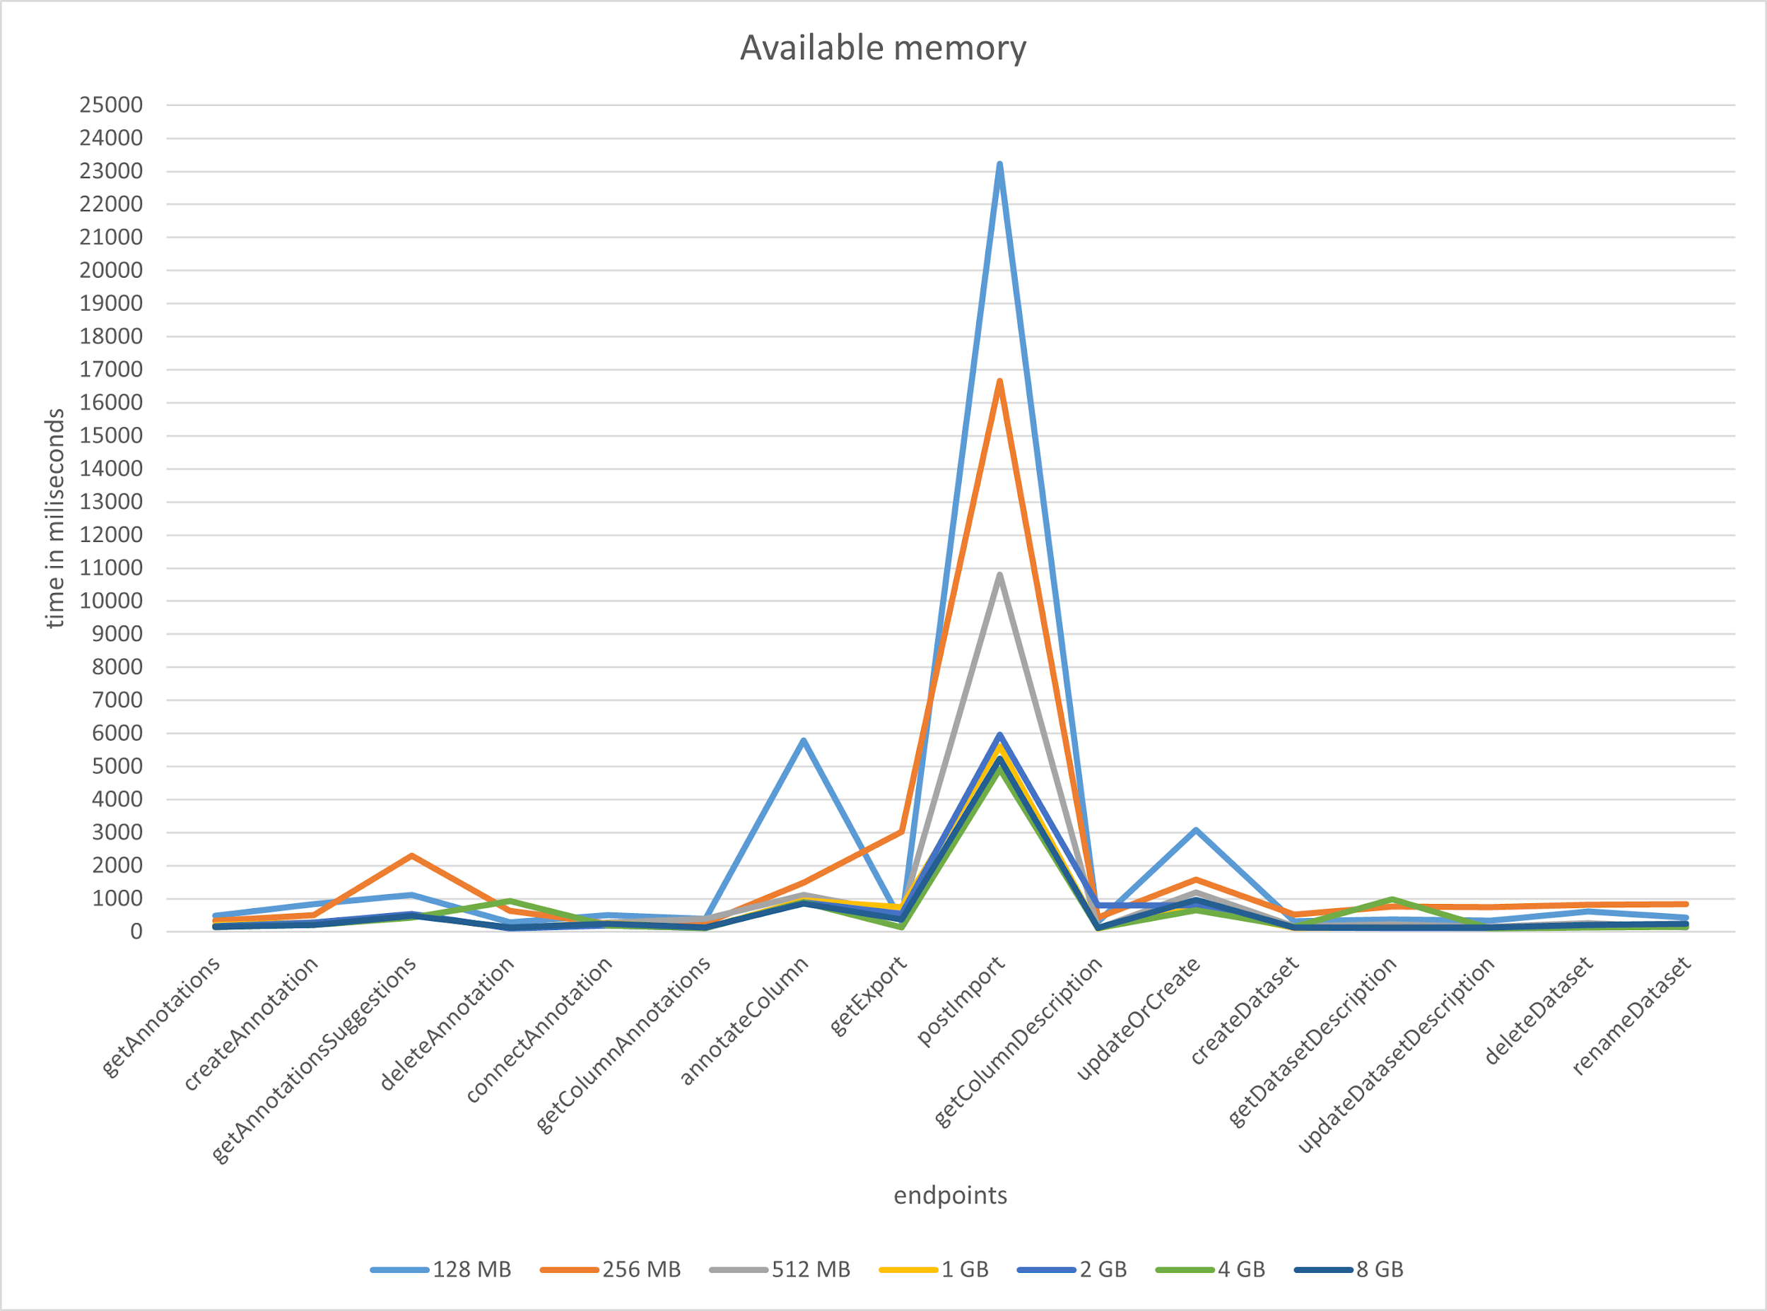
Memory Allocation Analysis

Slide 22
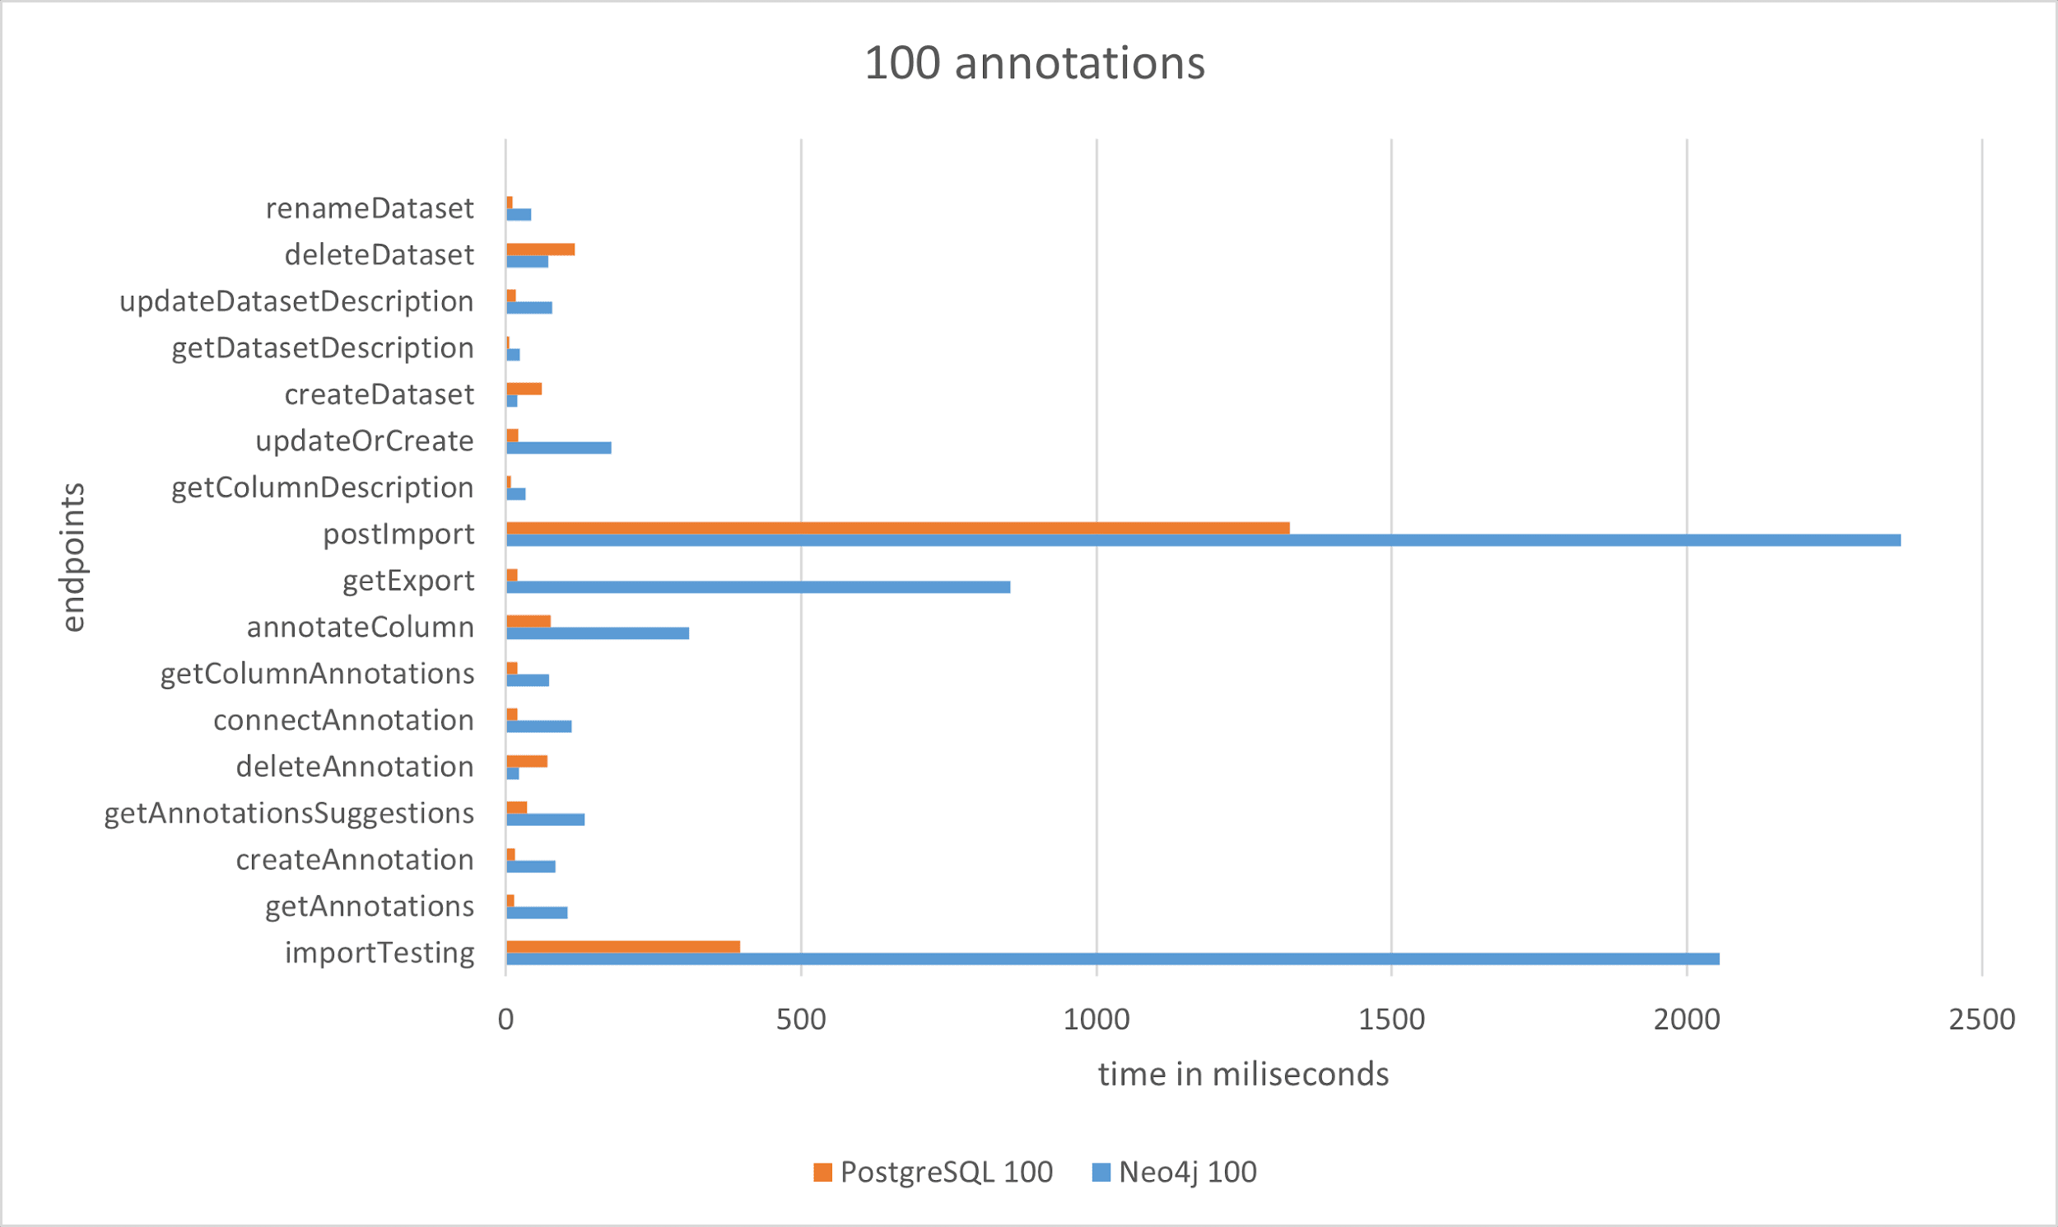
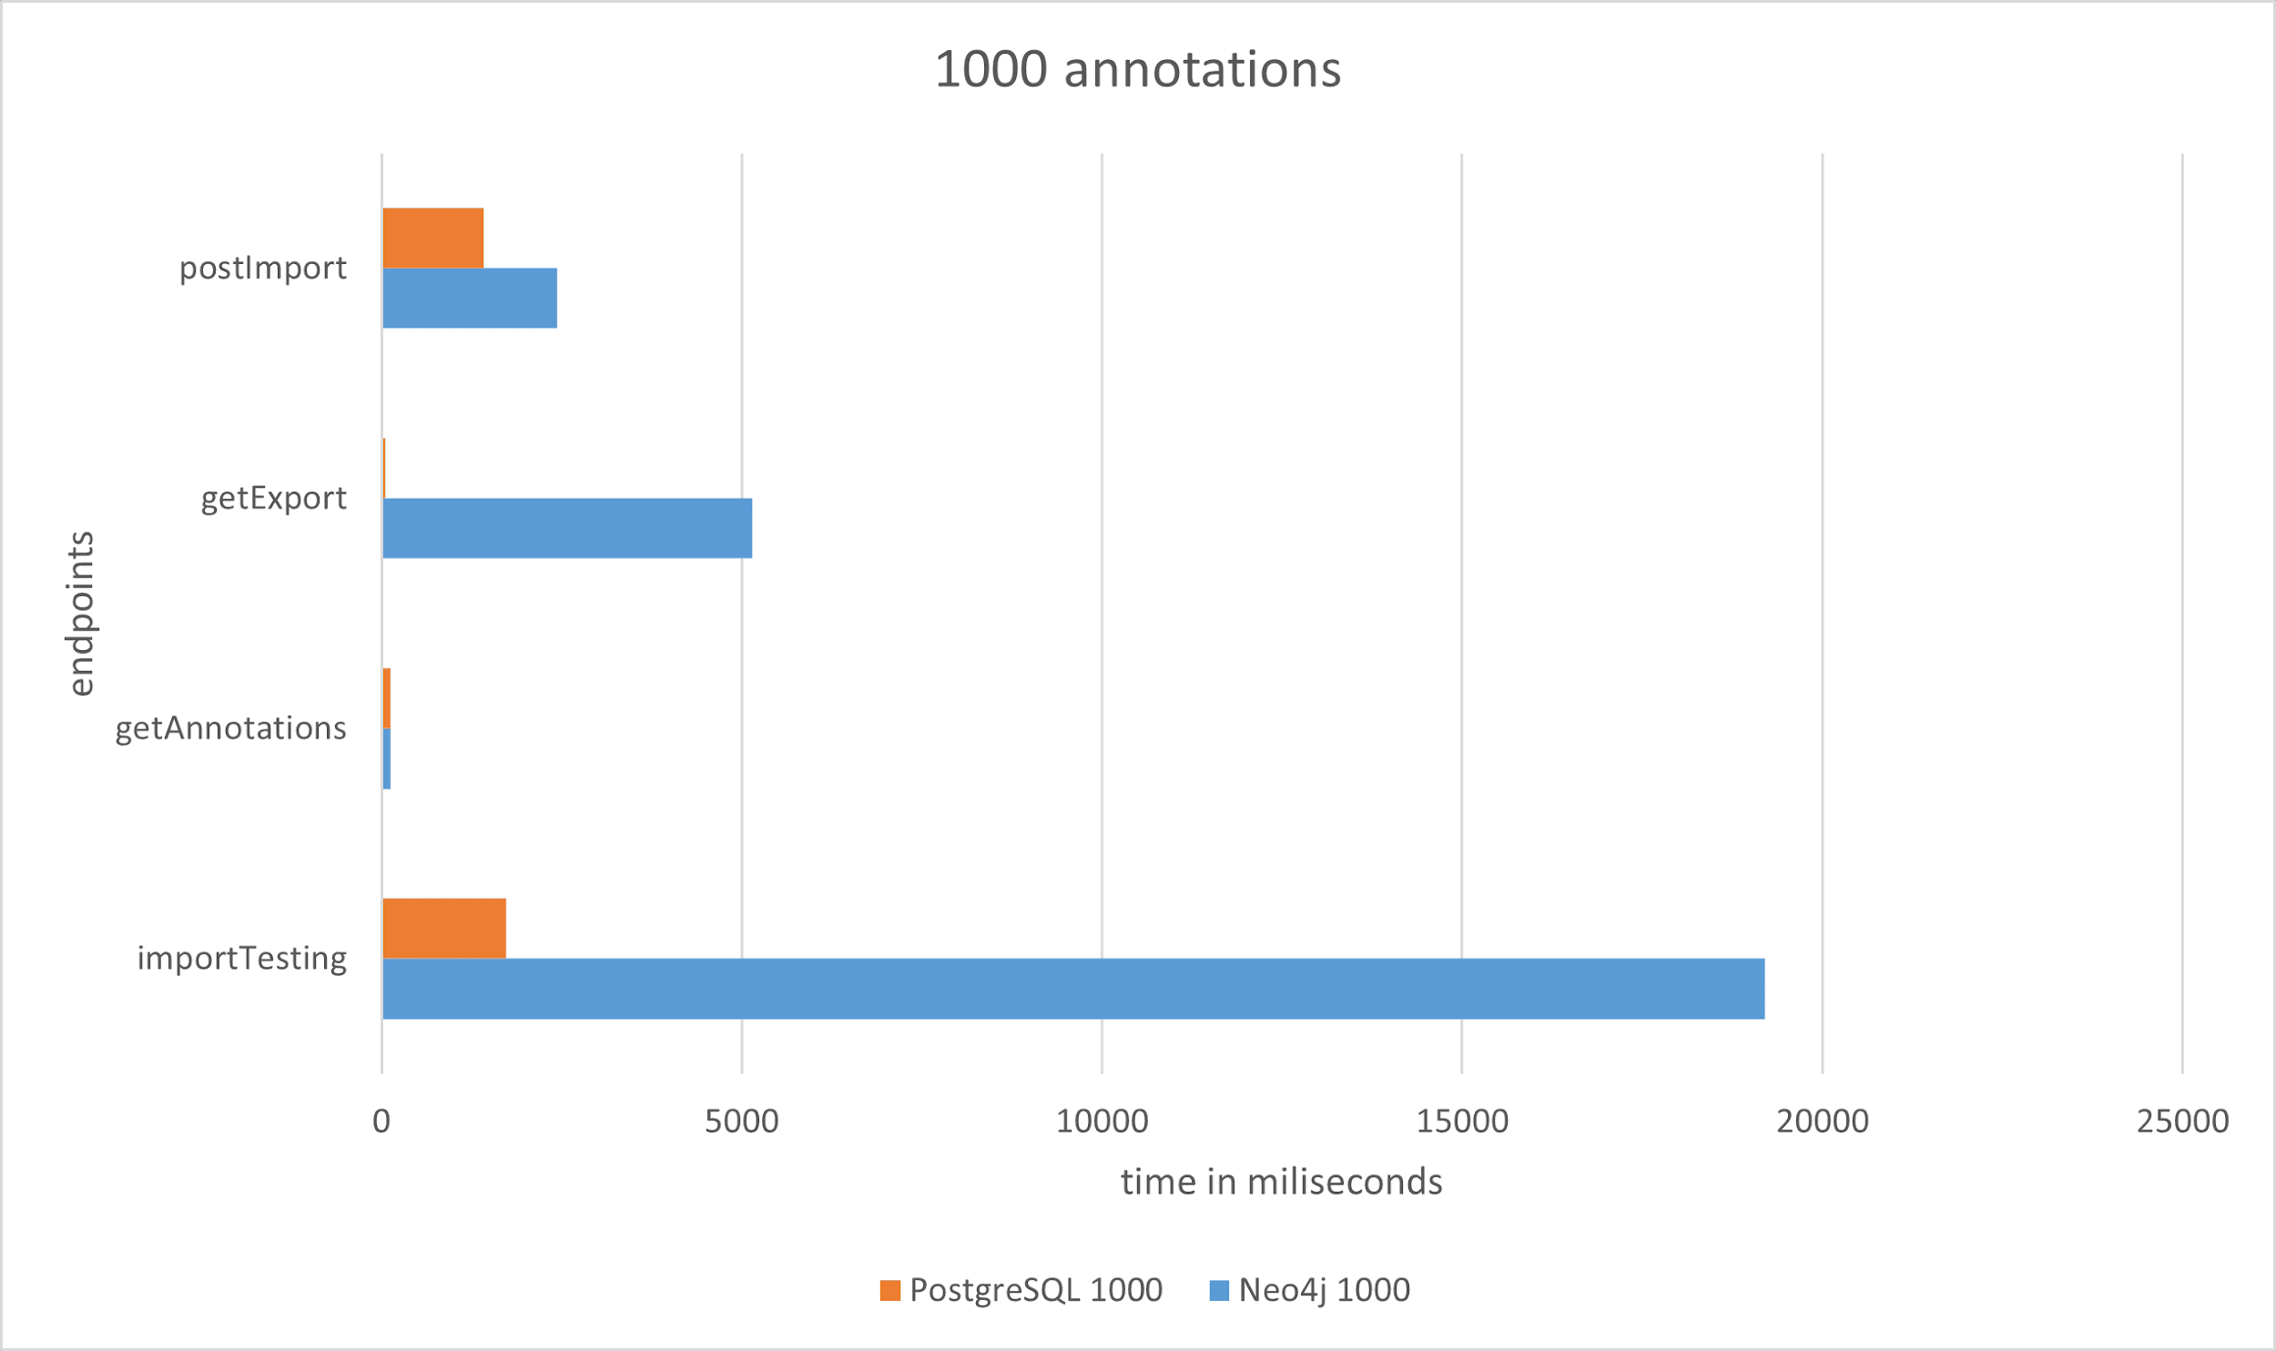
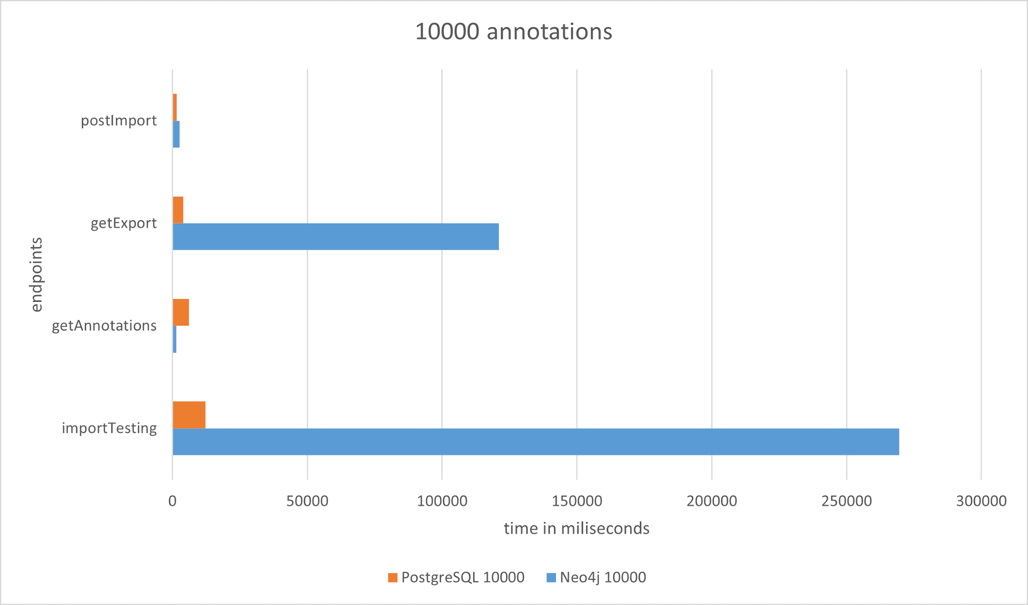
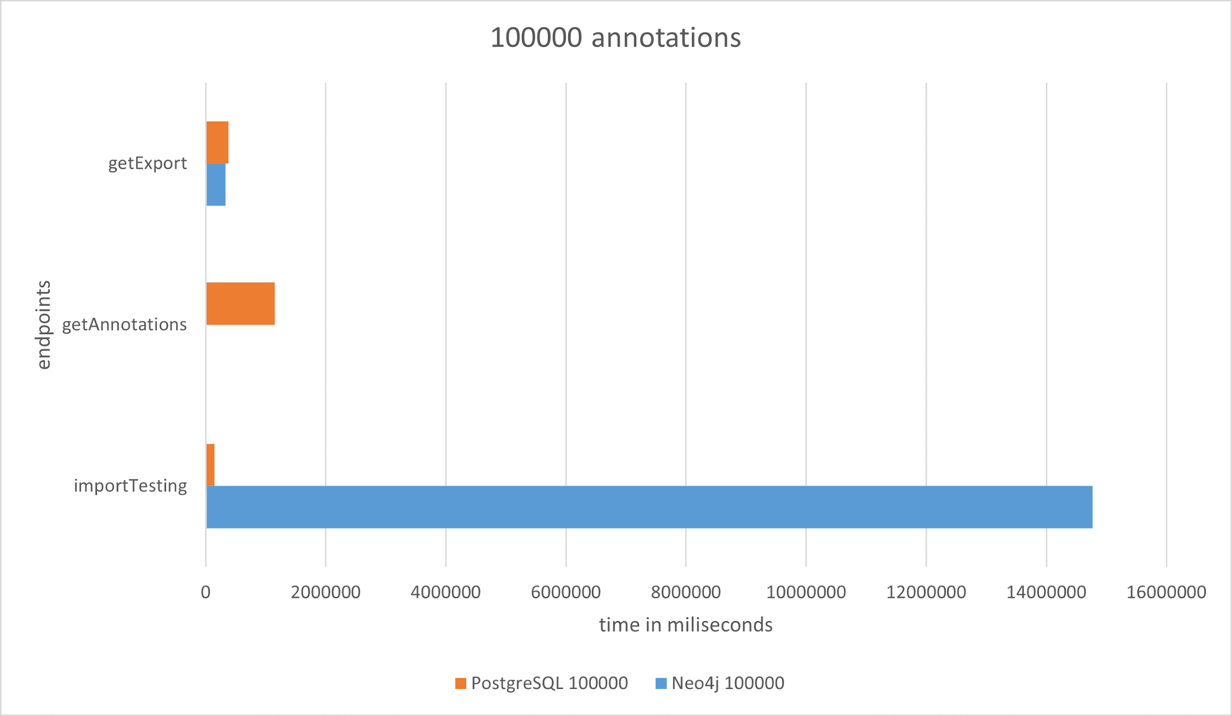
Neo4j versus PostgreSQL

Slide 23
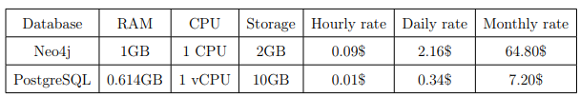
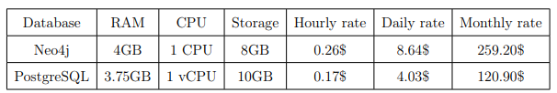
Cost considerations
Most economical option
Equivalent computing capabilities

Slide 24
Recapitulation
Created a database model, wireframes, and flow diagrams
Developed a web-based tool for dataset management and semantic annotation
Created a working CI/CD pipeline and deployed the application on GCP
Conducted user testing
Analyzed optimal regions
Compared monolith vs. microservices architectures
Conducted memory allocation analysis
Compared Neo4j versus PostgreSQL
Notes:
https://diploma-thesis-project-c46d9.web.app/

